Slide 1
CREDIT CARD DEFAULT PREDICTION
DETAILED PROJECT REPORT
Ahamed Ajas S
Afrin S
iNeuron

Slide 2
PROJECT DETAIL
Project Title | Credit Card Default Prediction
Technology | Machine Learning Technology
Domain | Banking
Project Difficulty level | Intermediate
Programming Language Used | Python
Tools Used | NumPy, Pandas, R, Tableau, MS-Excel, MS-Power BI

Slide 3
OBJECTIVE
The Goal of credit card default prediction is to develop a predictive
model that can accurately identify whether a credit card holder is
likely to default on their payments in the upcoming month.

Slide 4
PROBLEM STATEMENT
Financial threats are displaying a trend about the credit risk of
commercial banks as the incredible improvement in the financial
industry has arisen. In this way, one of the biggest threats faces by
commercial banks is the risk prediction of credit clients. The goal is to
predict the probability of credit default based on credit card owner’s
characteristics and payment history.

Slide 5
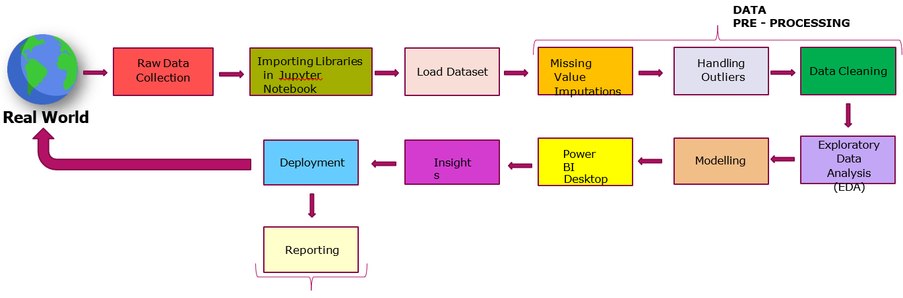
ARCHITECTURE

Slide 6
DATASET INFORMATION
ID: ID of each client
LIMIT_BAL: Amount of given credit in NT dollars (includes individual and family/supplementary credit
SEX: Gender (1=male, 2=female)
EDUCATION: (1=graduate school, 2=university, 3=high school, 4=others, 5=unknown, 6=unknown)
MARRIAGE: Marital status (1=married, 2=single, 3=others)
AGE: Age in years
PAY_0 to PAY_6: Repayment status in September, 2005 (-1=pay duly,1=payment delay for one month,
2=payment delay for two months, 8=payment delay for eight months,9=payment delay
for nine months and above)
BILL_AMT 1 to BILL_AMT 6: Amount of bill statement for the last 6 months.
PAY_AMT 1 to PAY_AMT 6: Amount of previous payment made for the last 6 months.
Default.payment.next.month: Target variable indicating whether the individual will default on the credit card
payment next month (1 = yes, 0 = no).

Slide 7
ID: While the ID itself might not directly contribute to predicting defaults, it serves as a unique
identifier for each record, helping in data management and referencing.
Limit Balance: The credit limit or balance is a crucial factor as it represents the maximum amount a credit card holder can borrow. Higher limits may indicate higher risk, especially if not managed responsibly.
Sex: Gender can be a demographic factor that influences financial behaviors. Some models consider it as a feature, although it's important to handle such variables ethically and ensure they don't contribute to bias or discrimination.
Education: The level of education can influence financial literacy and stability. It may provide insights into a person's ability to manage credit responsibly.
Marriage: Marital status can be a factor in financial stability. For example, married individuals may have shared financial responsibilities, potentially impacting their credit behavior.
Age: Age is a critical factor as younger individuals may have less financial experience and stability. Older individuals may have a more established credit history, providing insights into their creditworthiness.
Bill Amount: The bill amounts across different months indicate the credit card holder's spending behavior. Higher bill amounts relative to the credit limit may suggest financial stress.
Pay Amount: Payment amounts reflect how much of the billed amount the cardholder is repaying. Consistently low payments or delayed payments may indicate financial distress and an increased risk of default.
Default Payment Next Month: This is the target variable that the model aims to predict. It indicates whether a customer will default on their payment in the next month. Understanding and predicting this outcome is the primary objective of credit card default prediction models.
Why THESE PARAMETERS ARE IMPORTANT?

Slide 8
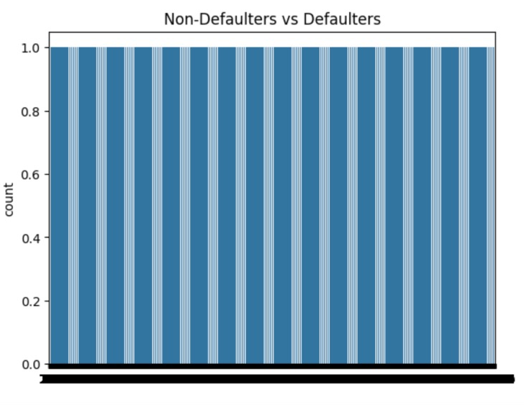
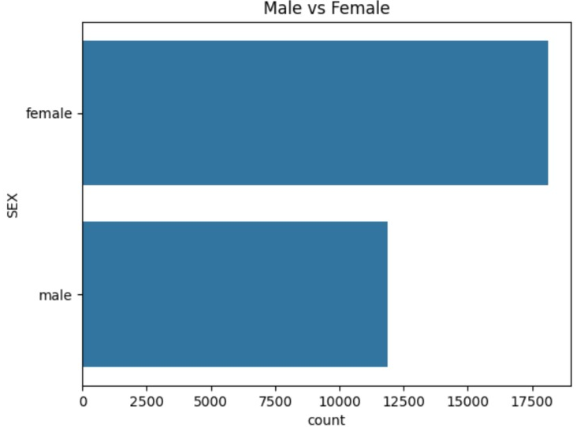
INSIGHTS
What Kind Of Population do we have?
0.5 Non Defaulters and 1.0 Defaulters
Females have higher count than men.

Slide 9
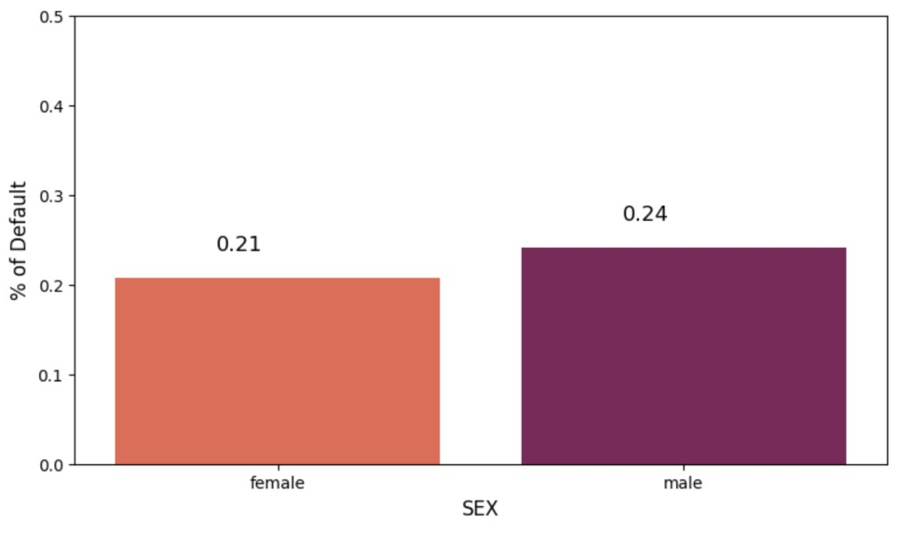
Males or Females who are more likely to default next month ?
So, from plot we can say Males are more likely to Default next month than females

Slide 10
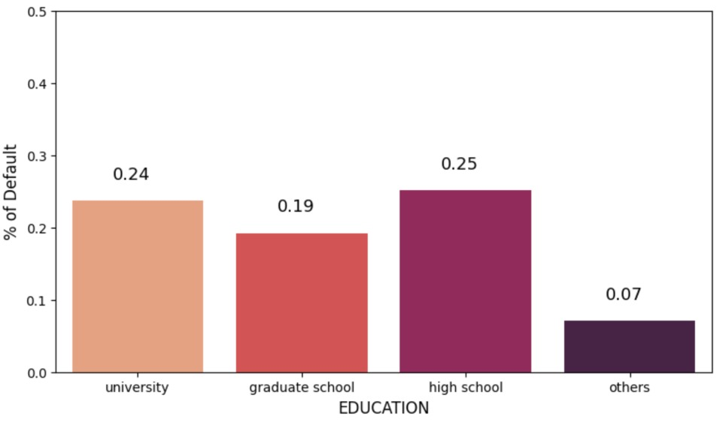
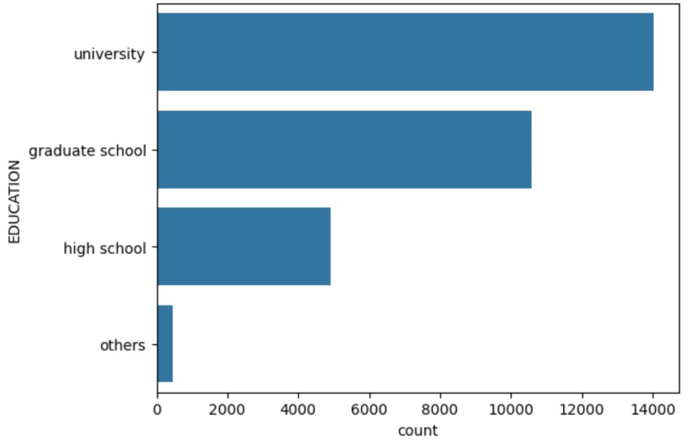
Which level of education shows a higher likelihood of default ?
The predominant level of education in our dataset is “University” , followed by ‘ Grade School’, ‘High School’ and ‘Others’.
From plot, Highschool and University candidates are more likely to Default.

Slide 11
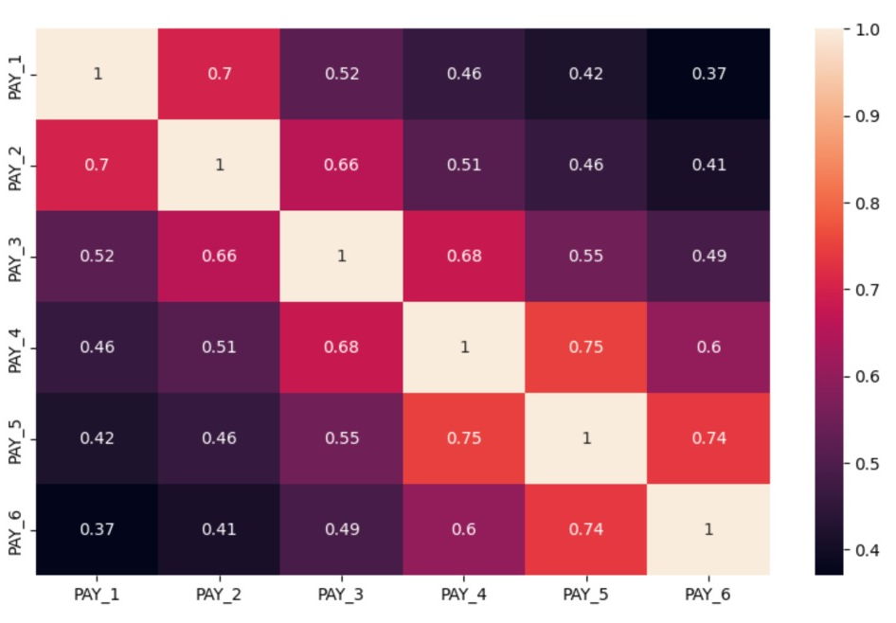
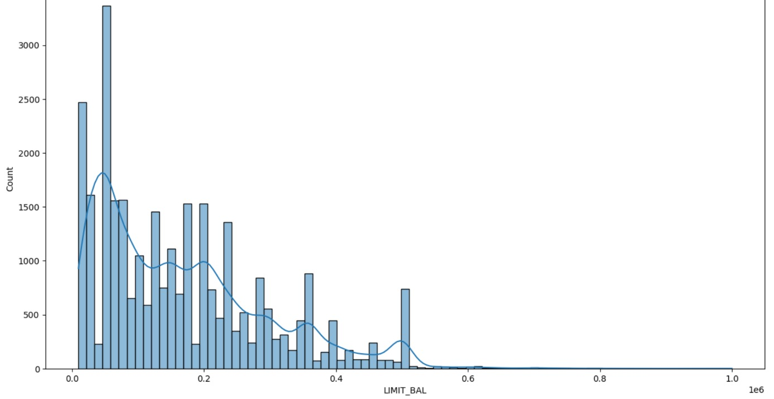
Visualizing the distribution of limit balances according to months.
It represents the maximum amount a credit card holder can borrow

Slide 12
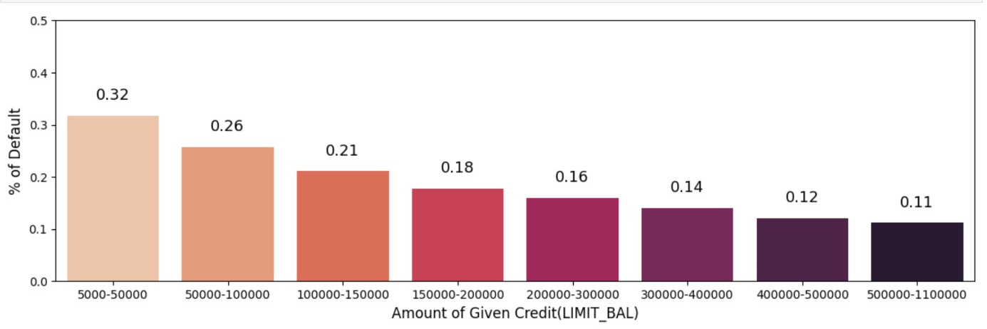
Is there a noticeable trend in default rates based on credit limits in the dataset?
Now, we got the clear picture that there is a significant rate of default ( over 30%) from customers with 50k or less of credit limit.
We also can say that the higher the limit, the lower is the chance of defaulting

Slide 13
KPIs (Key Performance Indicators)
Impact of Credit Utilization on Default Probability
Impact of Payment History on Default Probability
Influence of Debt-to-Income Ratio on Default Probability
Influence of Employment Status on Default Probability
Influence of Age on Default Probability

Slide 14
CONCLUSION
0.5 Non Defaulters and 1.0 Defaulters
Females have higher count than men.
Males are more likely to Default next month than females
The predominant level of education in our dataset is “University” , followed by ‘ Grad School’,
‘High School’ and ‘Others’.
From plot, Highschool and University candidates are more likely to Default.
It represents the maximum amount a credit card holder can borrow
we got the clear picture that there is a significant rate of default ( over 30%) from customers
with 50k or less of credit limit.
We also can say that the higher the limit, the lower is the chance of defaulting.

Slide 15

Q & A
Q1) What's the source of dataset ?
Ans) The Dataset was taken from iNeuron’s Provided Project Description Document.
https://www.kaggle.com/datasets/uciml/default-of-credit-card-clients-dataset/data
Q2) What was the type of data ?
Ans) The data was combination of numerical and categorical values.
Q3) What’s the complete flow you followed in this project ?
Ans) Refer Slide 5th for better understanding.
Q4) What Techniques were you using for data ?
Ans)
- Visualizing relation of independent variables with each other & output variables.
- Removing unwanted attributes.
- Removing outliers.
- Cleaning data imputing if null values are present.
- Converting data into Categorical Values.
Q5) What were the libraries that you used in python ?
Ans) We used Pandas, NumPy and Matplotlib and Seaborn libraries in Pandas.

Slide 16


